Slide 1
Tagging

Slide 2
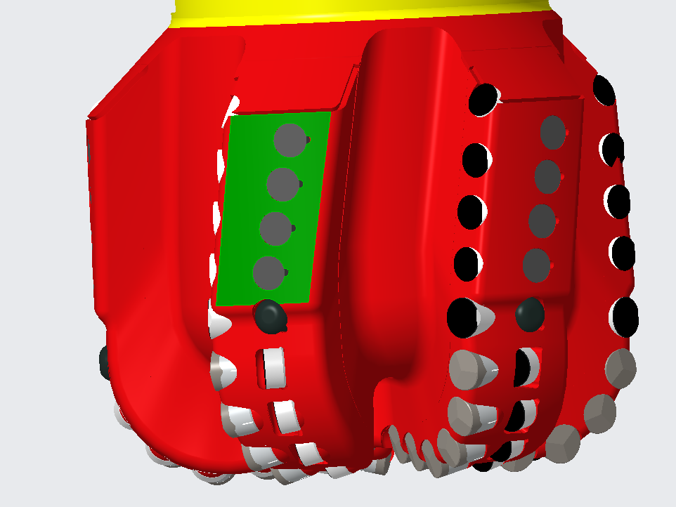
Bit Tagging
Tag gauge pad surface only (highlighted green in image)
Be sure to separate pads if grouped to ensure pads are assigned unique names
Open gauge pad surface group
Copy-paste (ctrl+c, ctrl+v) surface group
Options > "Exclude surfaces and Fill holes"
Using Ctrl+left click select surfaces elements to be deleted
Repeat until each pad is its own unique surface group

Slide 3
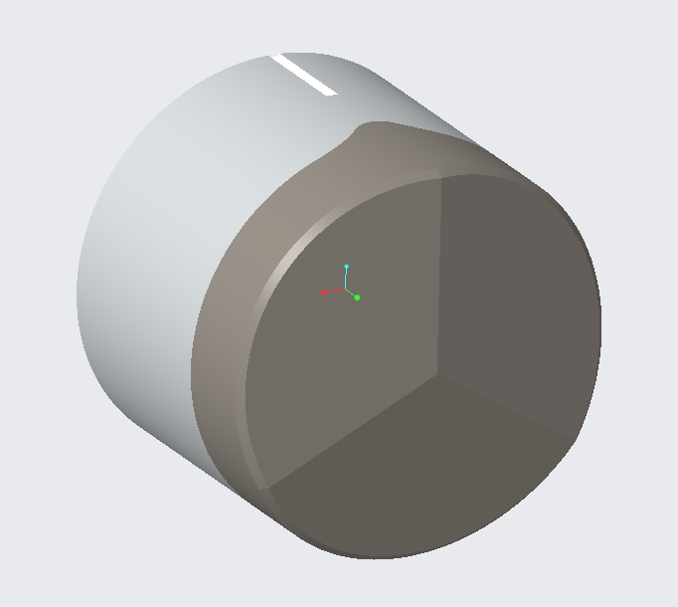
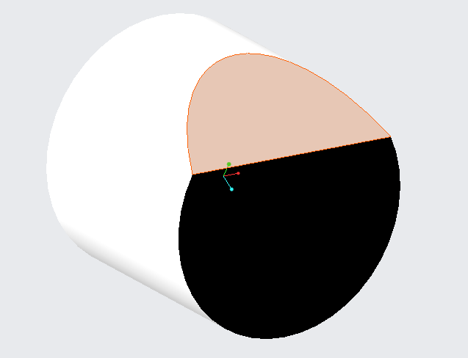
Cutter Tagging
Cutter body
(all remaining pieces not chamfer or face)
Tag cutter elements as shown in image
Cutter body
(all remaining pieces not chamfer or face)
Cutter chamfer (edge surface)
Cutter face
Cutter face

Slide 4
Last Slide

